Slide 1
Phillips Metal Injection Molding
Skip Swanson
Manager
August 5, 2011

Slide 2
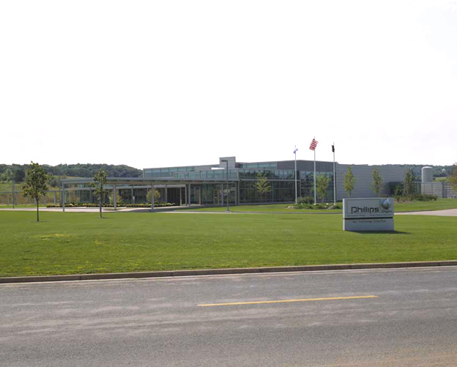
Phillips Metal Injection Molding
Stout Technology Park Menomonie, WI
www.phillipsplastics.com
Notes:
GREETING
BRIEF REVIEW OF TODAYS INTENT TO PROVIDE AN OVERVIEW OF THE METAL INJECTION MOLDING PROCESS.
PRESENTATION TIME : 30 MINUTES
REQUEST HOLDING QUESTIONS TO THE END OF THE PRESENTATION OR WRITING THEM IN THE WEB EX FIELD IN THE LOWER RIGHT OF YOUR SCREEN.

Slide 3
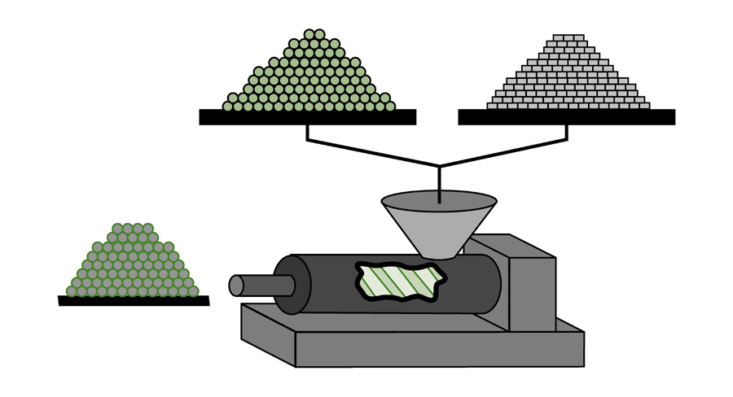
Raw Material Mixing and Pellitization
Process Keys:
Consistency of powder size distribution
Consistency of powder loading
Metal Powder
(-60% volume)
Metal Powder
(-60% volume)
Polymer
Powder
(-40% volume)
Polymer
Powder
(-40% volume)
MIM
Feedstock
MIM
Feedstock
Hot Mixer/Extruder
Hot Mixer/Extruder

Slide 4
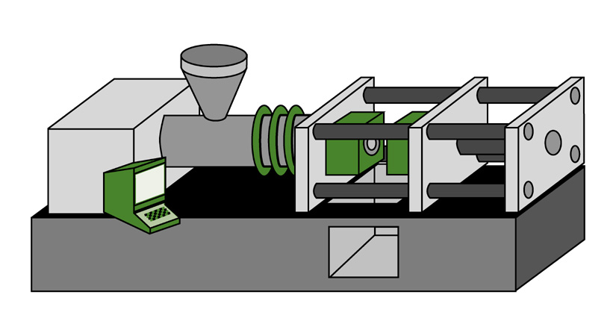
Molding
Heater
Bands
Process Parameters:
High viscosity
High thermal
conductivity
Tool Temperatures –
250º F
Heater
Bands
Mold
Mold
Injection Molding Machine:
Advanced instrumentation
Closed loop control from pressure transducer to assure ultimate uniformity in molded part weight

Slide 5
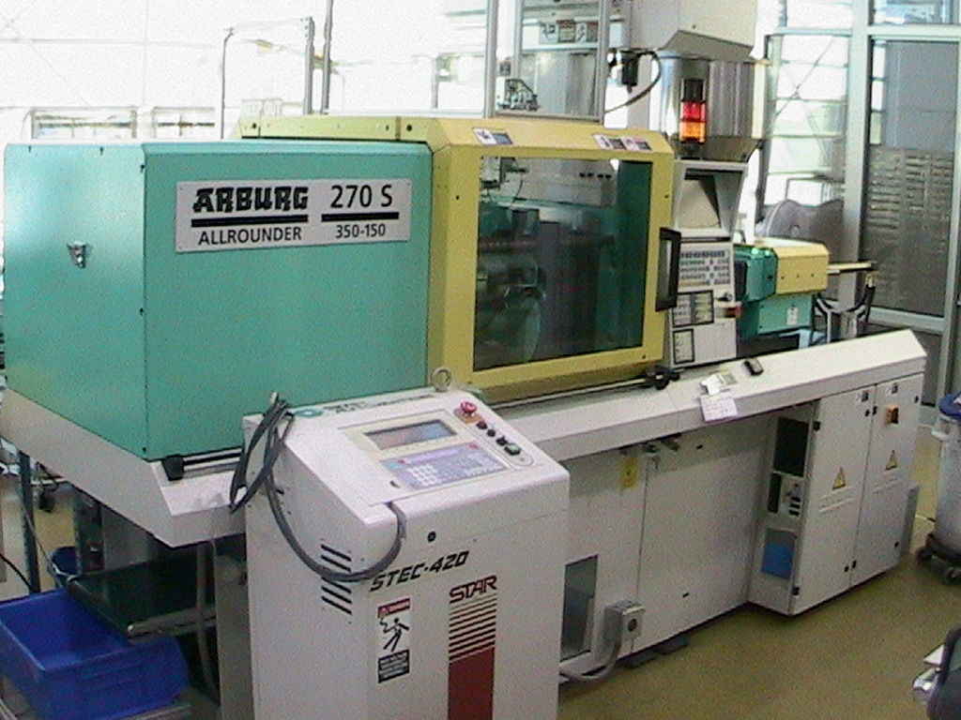

Slide 6
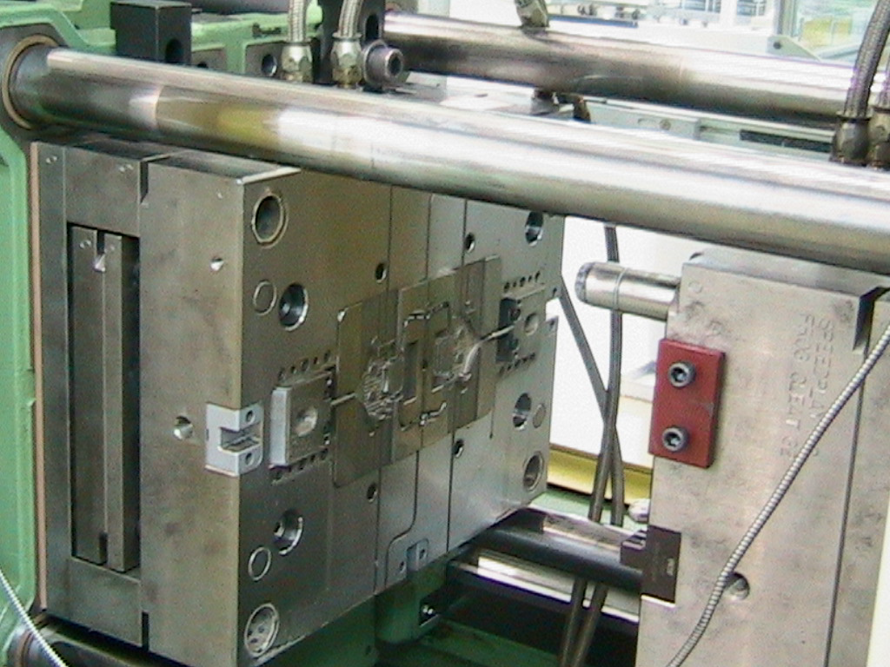

Slide 7
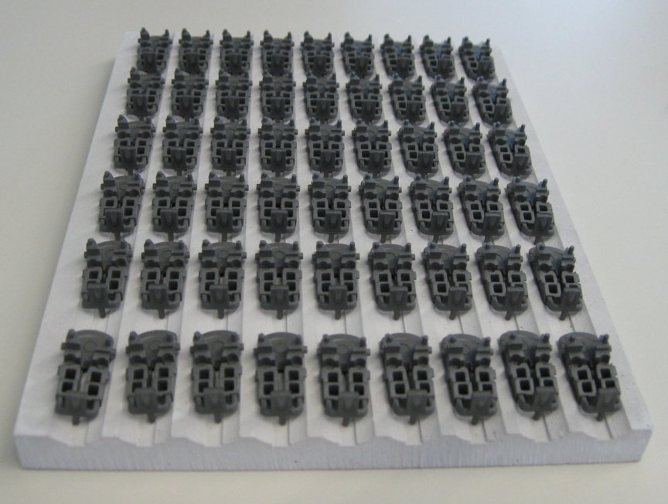
Custom Sintering Fixtures

Slide 8
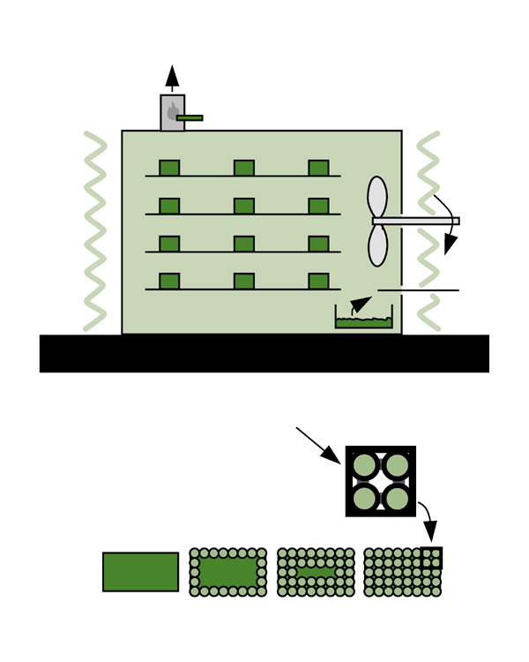
Catalytic Debinding
Exhaust Burner
Process Parameters:
Chemical reaction
Shrinking core mechanism
Temperature is below
softening point of binder
Exhaust Burner
Fan
Fan
Heater
Coils
Heater
Coils
s
Catalyst
Secondary
Binder
Secondary
Binder
Process Keys:
Fast (2-4 hours)
Clean
No distortion of parts
Shrinking Core Mechanism
Shrinking Core Mechanism

Slide 9
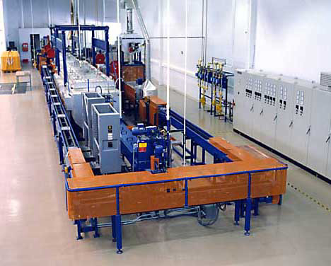
Continuous Debind and Sintering
Process Parameters:
Temperature ramp to 1350° C
16-20 hour cycle door-to-door
Hydrogen or nitrogen
atmosphere
Sintered density 97-99%
of theoretical or wrought

Slide 10
Continuous Debind and Sintering

Slide 11
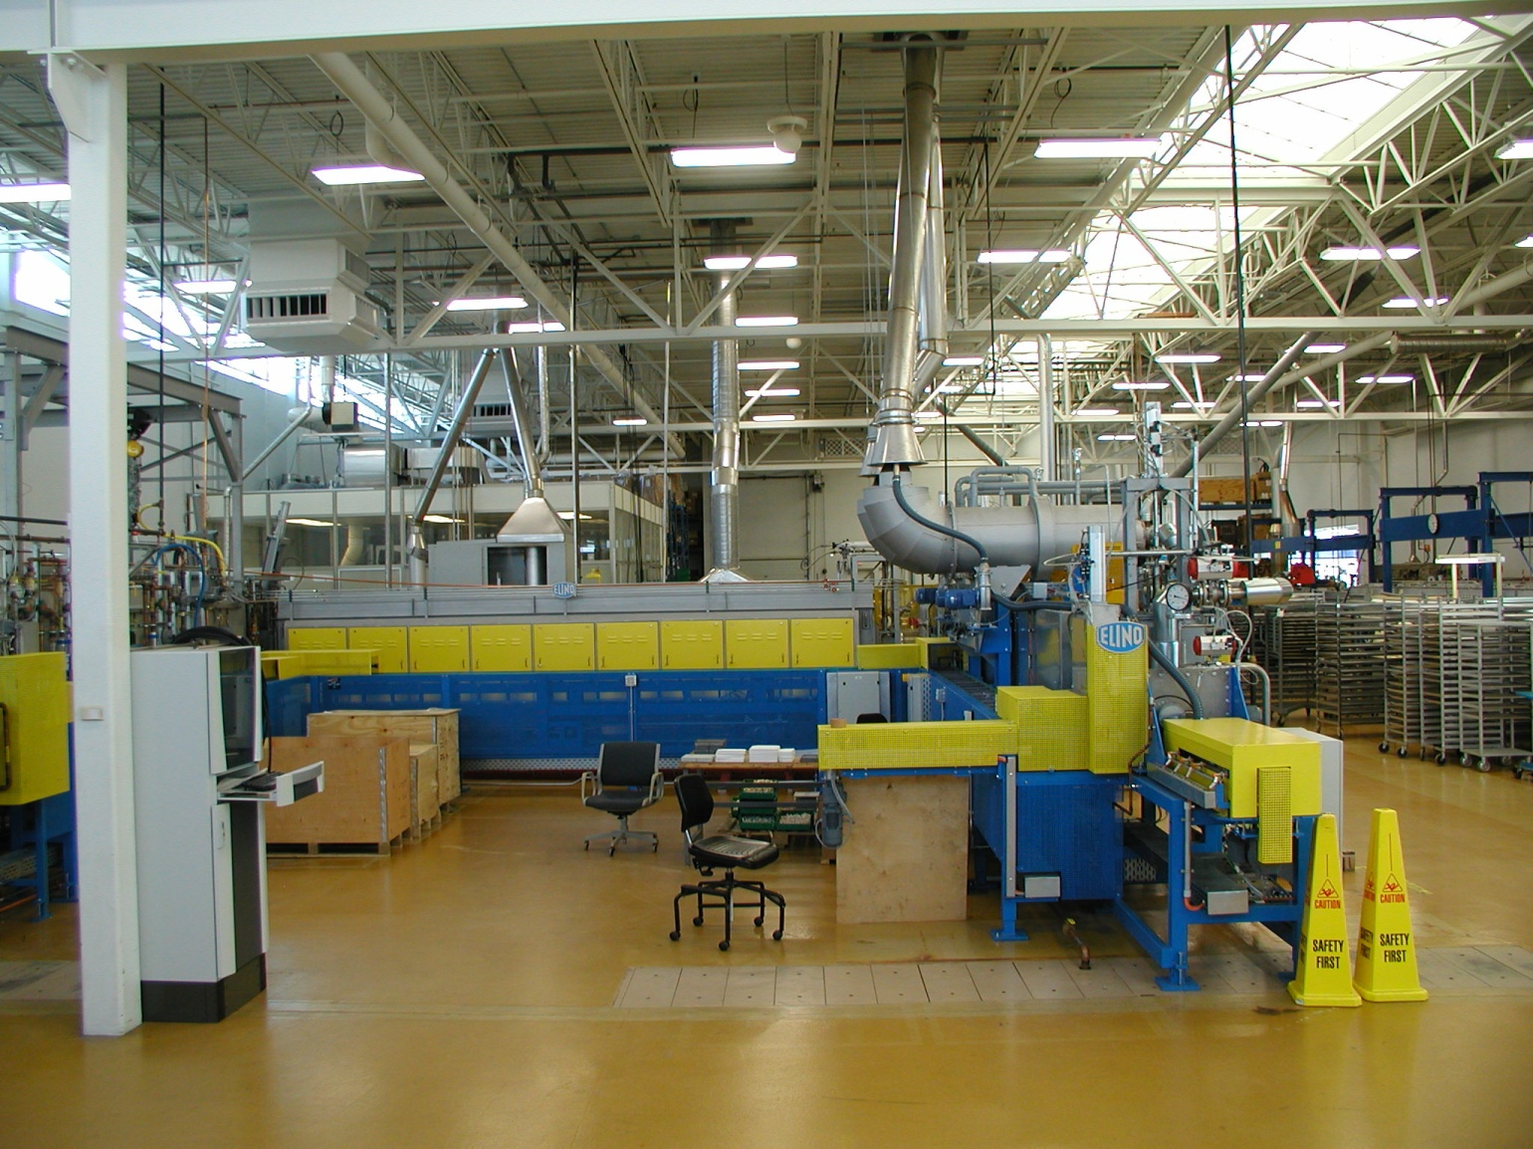
Continuous Debind and Sintering

Slide 12
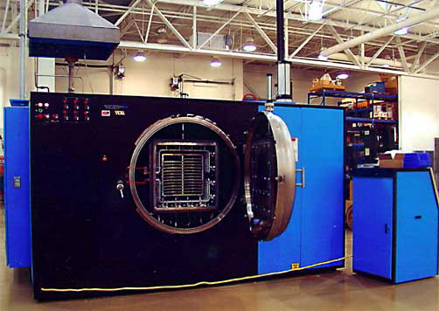

Slide 13
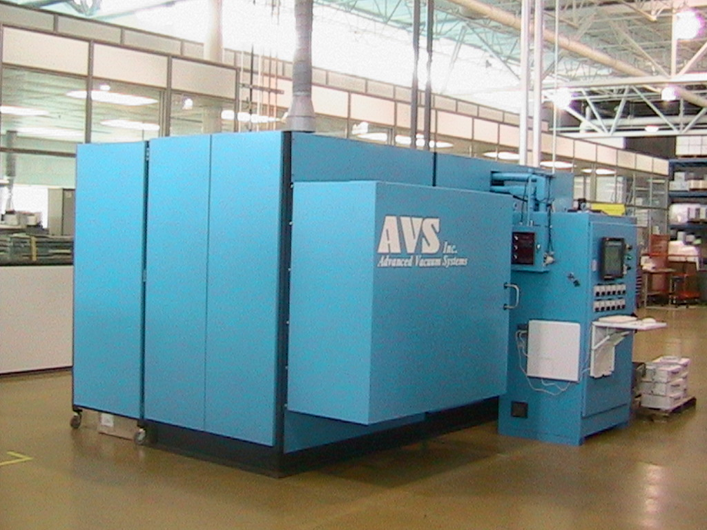

Slide 14
Endo Stitch program
The ENDO STITCH™ single use suturing device has application in endoscopic surgery for the placement of interrupted or running stitches in soft tissues.

Slide 15
ENDO GIA Universal Stapler
Retainer
Pivot
Upper pivot

Slide 16
Metal Injection Molding Design Examples
MIM design eliminated a 7 piece assembly
Parts previously were fine blanked and then three bosses assembled with screws
Significantly reduced component cost

Slide 17
Auto-unscrewing Tools
Four cavity tool
0-80 auto-unscrewing thread
Eight cavity tool
M2 X 0.4 auto-unscrewing thread

Slide 18
Educational Partenerships
UW – Stout
Chippewa Valley Technical College
UW - Eau Claire

Slide 19
Educational Partenerships
UW – Stout
Leadership Academy
Lean Manufacturing Training
Scientific Injection Molding Training
Industrial Technology graduates
Plastics Engineering
Manaufacturing Engineering
Product Development
People Process
Technical Interns
Continuing Education

Slide 20
Educational Partenerships
Chippew Valley Technical College
Electro Mechnical Education
Computer Software Training
Precision Inspection
Geometric Dimensioning and Tolerancing
Blueprint Reading
Negotiating Skills

Slide 21
Educational Partenerships
UW-Eau Claire
MBA Program
Leadership Training
Scanning Electron Microscope
Contour Observation
Fracture Analysis
Energy Spectrum Probe
Grain Boundary Analysis

Slide 22
Thank You!
www.phillipsplastics.com

