Slide 1


Thoughts, ideas and ponderings
Growing businesses is like growing any plant. Someone or something always has to sow the seed.

Slide 2
Common recommendations
Cultural setting
Climate
Creative class
Tax incentives
Enterprise zones
Reduce burdensome regulations
Low cost energy
Research university nearby

Slide 3



TREAT
YOUR
ENTREPRENEURS
LIKE
KINGS

Slide 4

















Slide 5
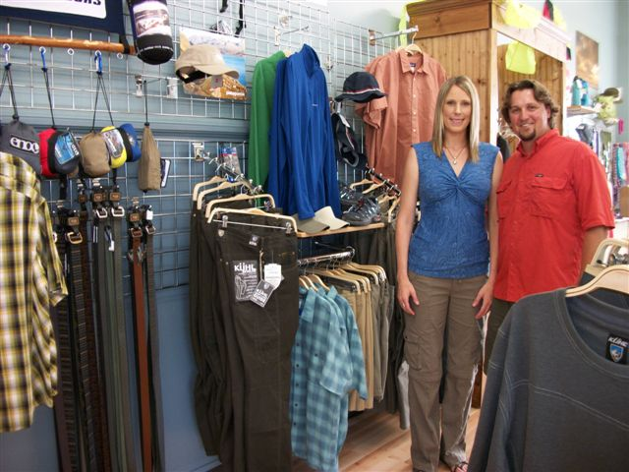
Solstice Outdoors
Katie and Dave Gellatly

Slide 6
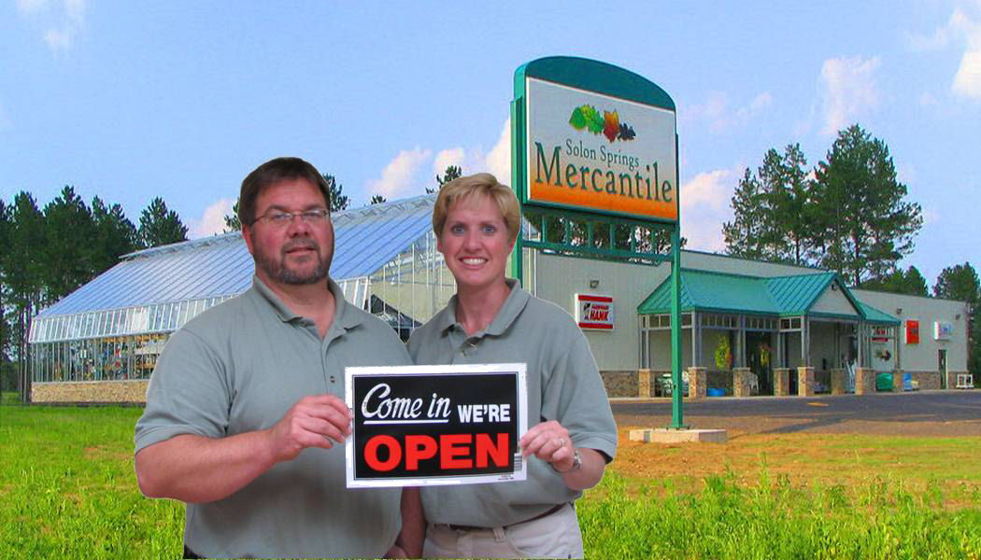
SBA Emerging Small Business Award 2006
Ken and Meg Thoreson

Slide 7
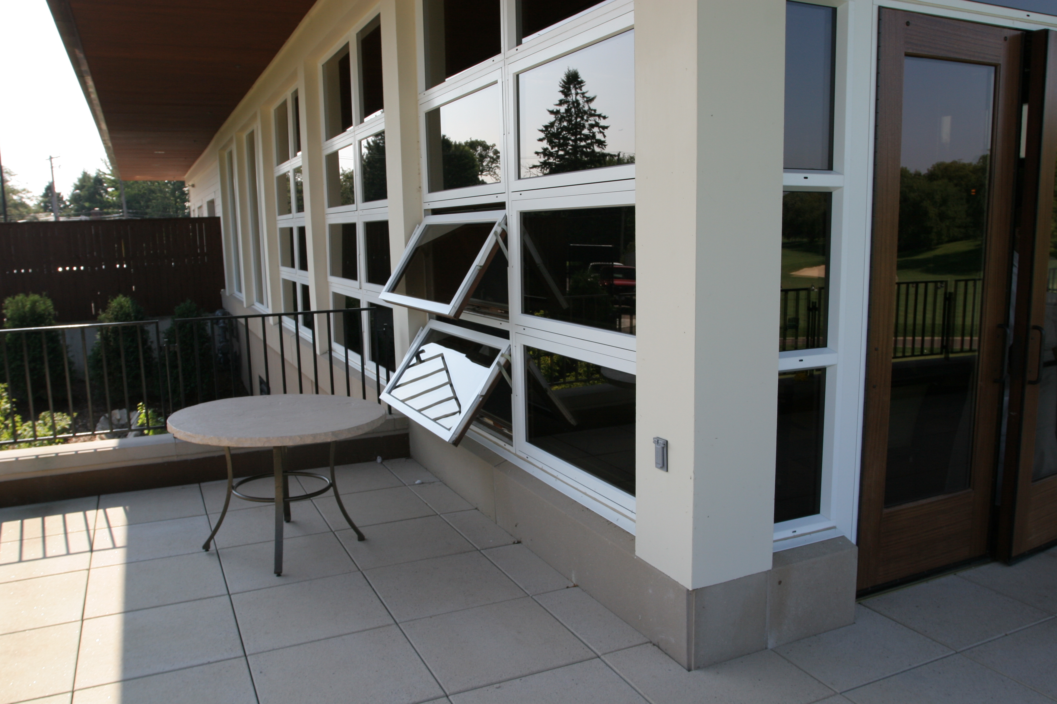

H Window Company LLC

Slide 8
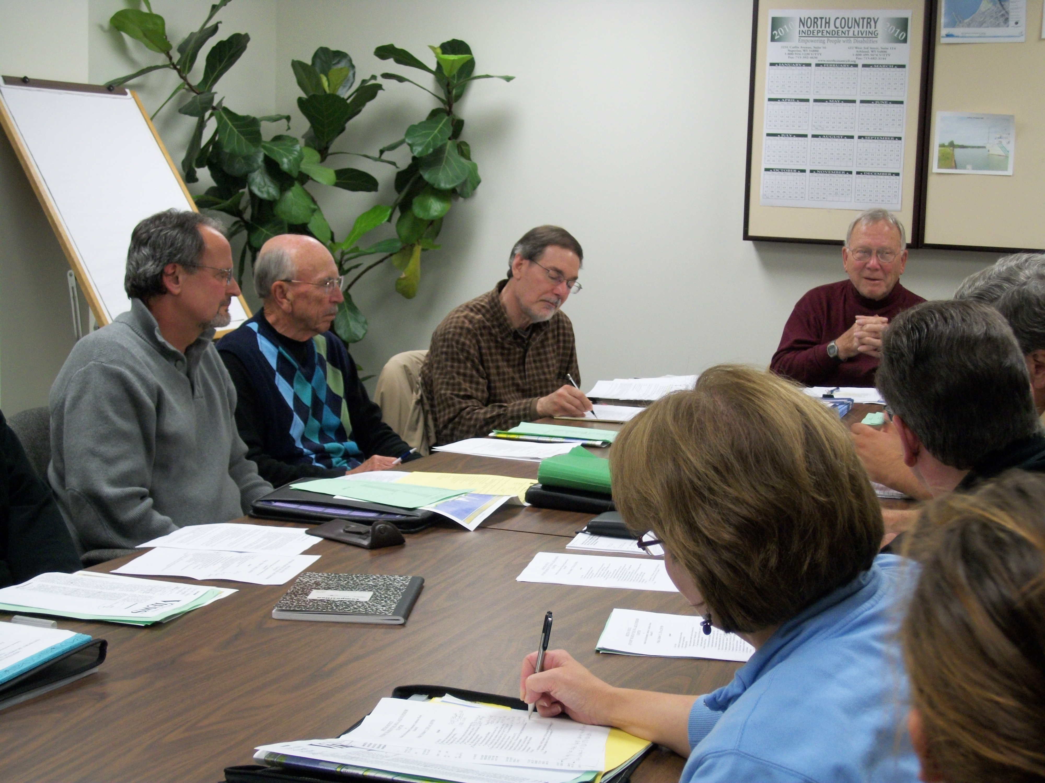
Lake Superior Chapter
WIN Advisory Board

Slide 9
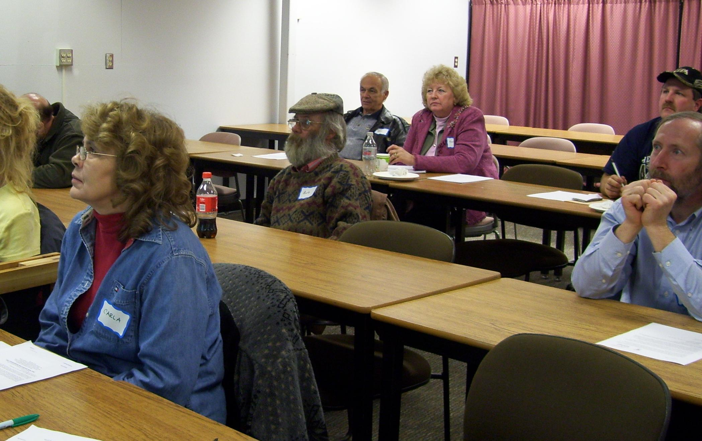
Inventors and Entrepreneurs Clubs

Slide 10
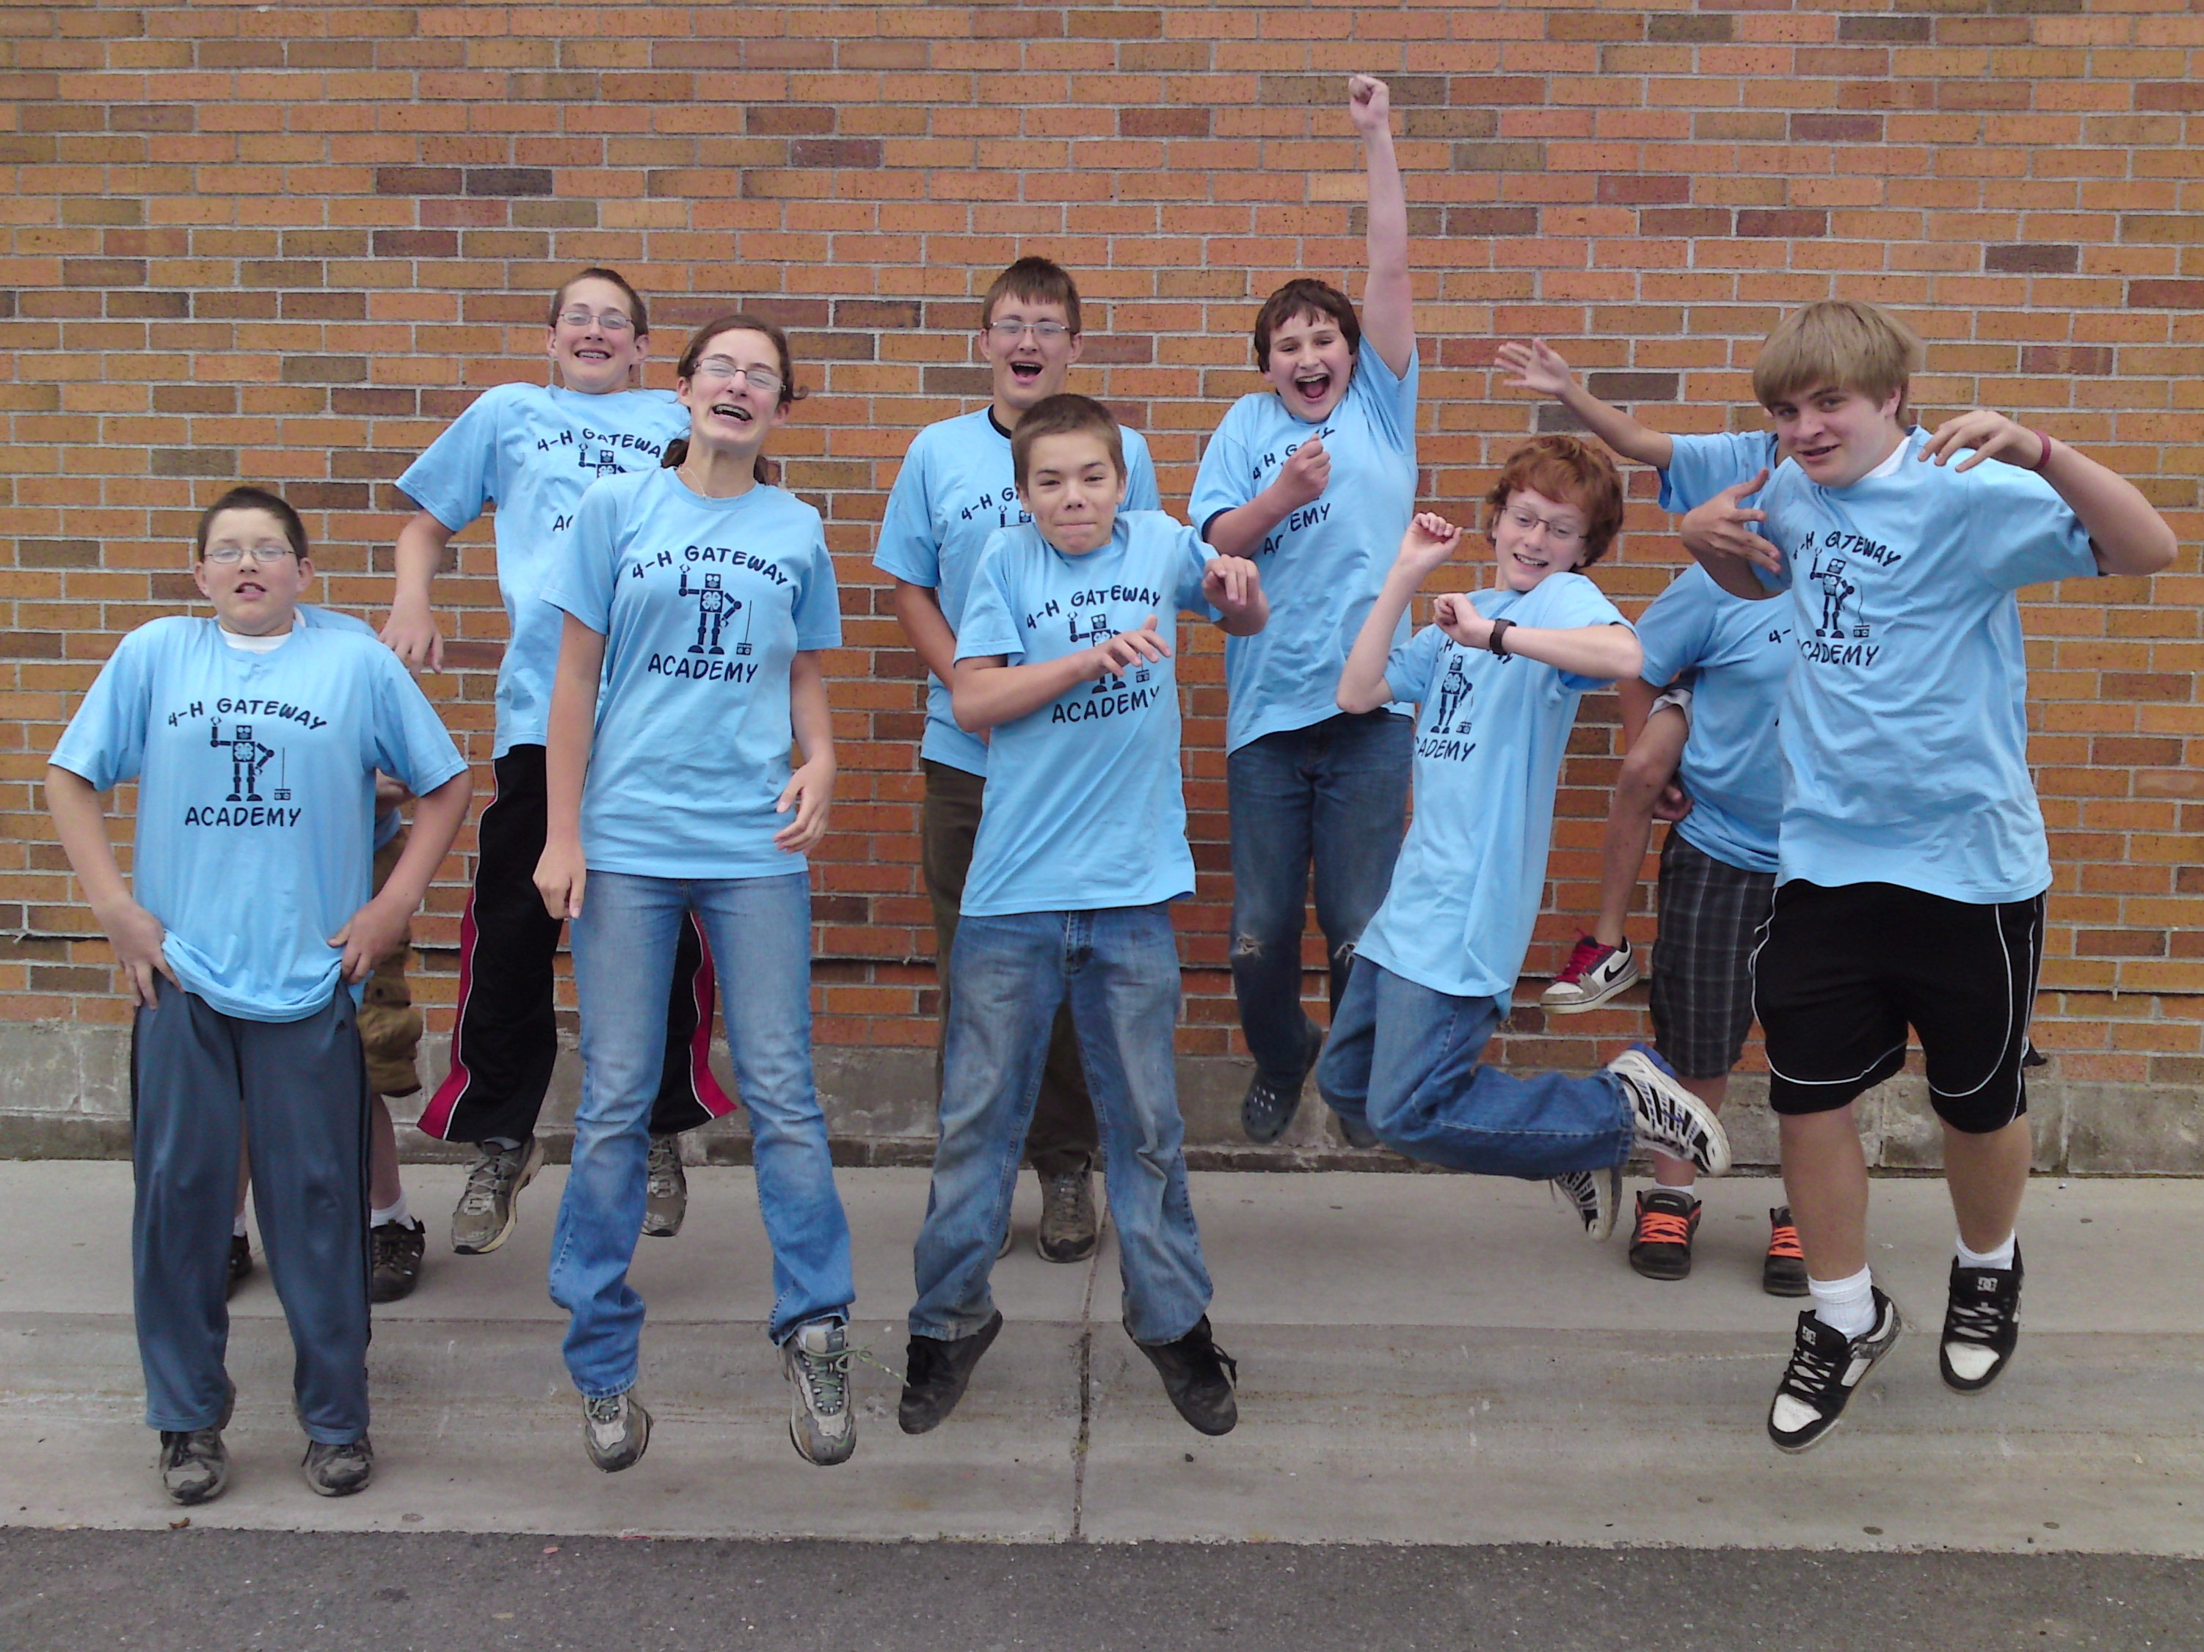

Slide 11

2
BUILD
MODERN NETWORK
INFRASTRUCTURE

Slide 12
Rural electric cooperatives
“Many [rural electric] cooperatives exist in the rural United States, and were created by the New Deal to bring electric power and telephone service to rural areas, when the nearest investor-owned utility would not provide service, believing there would be insufficient revenue to justify the capital expenditures required.”
Source: Wikipedia

Slide 13
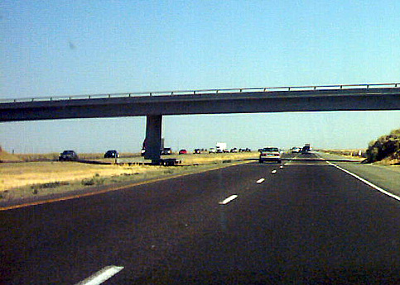
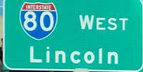
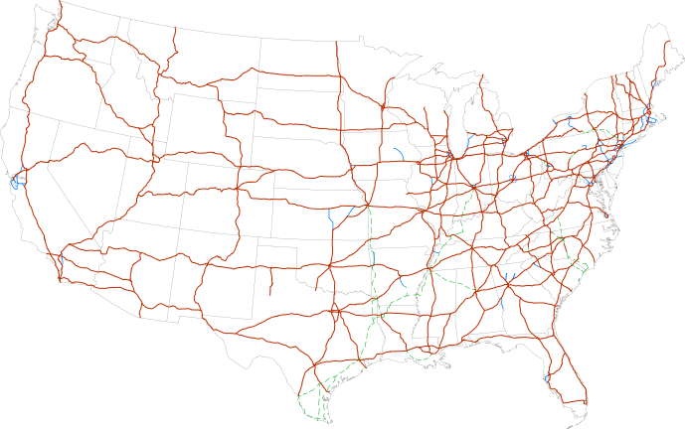
Interstate highway system

Slide 14

This is the next highway……...

Slide 15
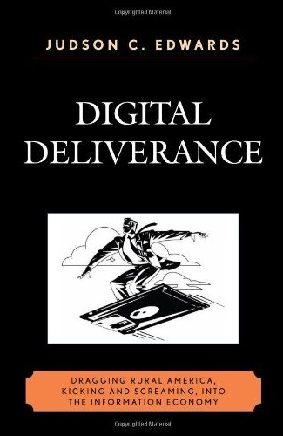
“The capability of information technology to make physical location less important has the potential to allow rural areas throughout the United States and the world to participate in the global economy without regard to geographic location.” (Turner, 2002)

Slide 16


Broadband users by country
China: 116 million
(March 2011)
United States: 83 million
(June 2010)

Slide 17

Broadband users by state
Rank/Name Speed (DL 3+/UL 0.7+)
District of Columbia 100%
11. Illinois 99.3%
13. Ohio 99.3%
17. Michigan 99.1%
26. Minnesota 98.5%
33. Iowa 96.7%
35. Louisiana 96.4%
39. Mississippi 93.8%
43. Wisconsin 88.2%

Slide 18
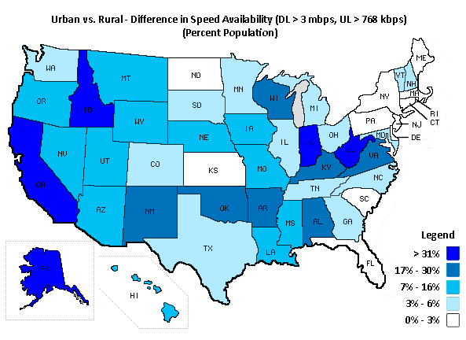
Notes:
The map illustrates the difference in speed availability in terms of percent of population, for the download greater than 3 mbps, upload greater than 768 kbps speed tier. This is calculated by subtracting the percent of the population with access to this speed in rural areas from the percent of the population with access to this speed in urban areas.

Slide 19
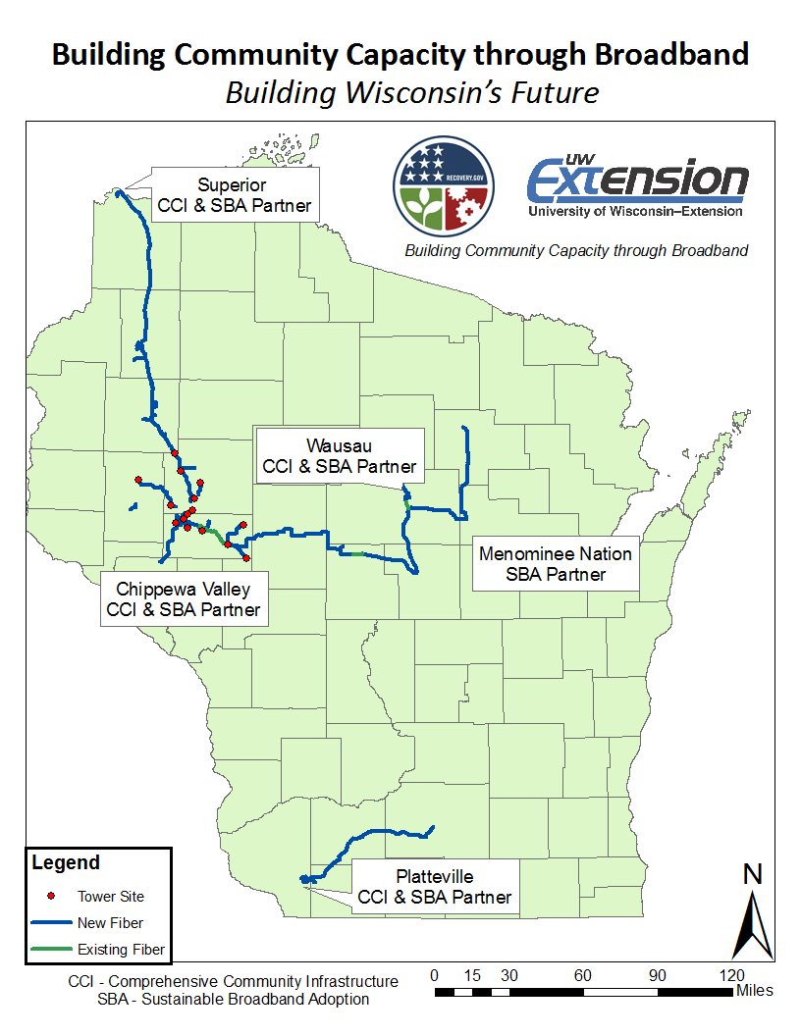

Slide 20







Energy
Government
Economic Development
Education
Civic Engagement
Public Safety
Health Care

Slide 21

















LEVERAGE
EXISTING
STRENGTHS
TO CREATE A
REGIONAL
THEME
3

Slide 22
Who are you attracting now?
People who like to be independent but connected
  Resourceful and independent individuals
People that love outdoor recreation and being close to nature
  Outdoor Life
People that would like to be self-sufficient
  Grow your own food, fuel and create your own business

Slide 23







Slide 24
Creating a Theme-Based Regional Culture
Can you create an inexpensive incubator area in your “Technology Park”?
Can you develop educational and training sessions like these?
  “growing your own energy”
  “growing, storing and selling your food”
  “bring your ideas and let’s build your business”
  “boot camp for entrepreneurs”

Slide 25

Why? This certainly is not “High-Tech”…

Slide 26





Slide 27
BLAH
BLAH
BLAH
BLAH
BLAH
BLAH
BLAH

Slide 28


Slide 29



kings
infrastructure
theme
SUMMARY

Slide 30
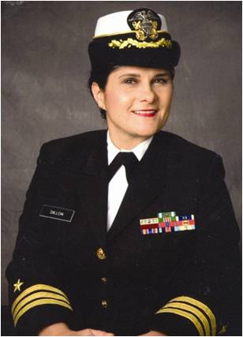
Commander Pat Dillon
The NW WEN office will be vacant due to Pat Dillon’s mobilization. Dave Linz, SE Regional Director, will be handling calls and emails.

Slide 31


University of Wisconsin
THANK YOU

Slide 32

Notes:
Why not do it the way you are used to?

