Slide 1
University of Wisconsin
Partnering with Communities to Stimulate Innovation, Creativity, and “Grow Jobs”

Slide 2
UW System structure
University of Wisconsin Board of Regents
University of Wisconsin System
2 Doctoral Universities (UW-Madison, UW-Milwaukee)
11 Comprehensive Universities
13 Freshman/ Sophomore Colleges
UW-Extension
Notes:
I want to give you a very brief overview of how the UW Colleges and UW Extension are meeting some of the unique needs of the Wisconsin economy in the spirit of the Wisconsin Idea.
I will say more later on how we’ve integrated the administration of these two institutions for greater efficiency.
How many of you are familiar with UW Colleges and UW-Extension? (hands)
These institutions are perhaps the least understood part of the entire UW System.

Slide 3
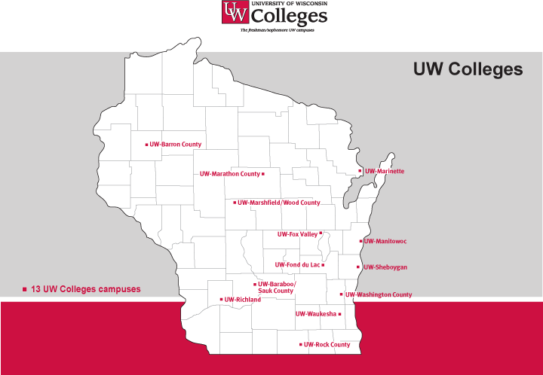
14,300 students
Notes:
First let me talk about the UW Colleges.
The UW Colleges is a system of 13 campuses, which this year are serving a record 13,807 freshmen and sophomores.

Slide 4
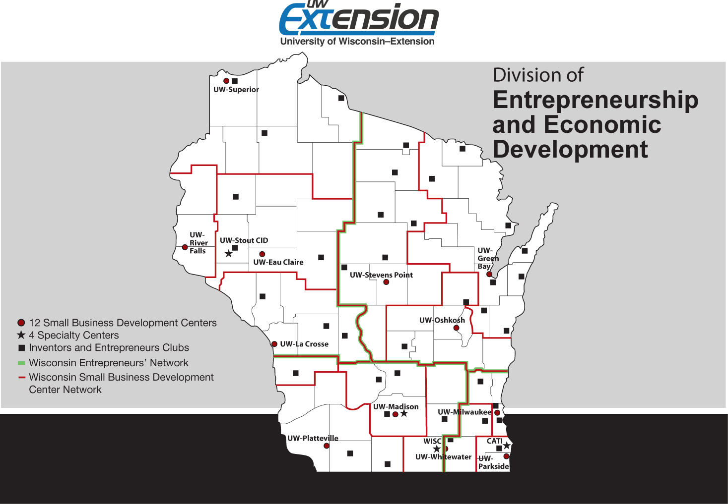
Notes:
We use a variety of strategies to reach people.
12 Small business development centers (graphic says 4 specialty centers – now is 3).
The Wisconsin Entrepreneurs Network
Inventors and Entrepreneurs Clubs

Slide 5
Experts and some “theories”
Observations and experiences
Thoughts and ideas
There are no economic development experts – but we have to blame someone!

Slide 7
Experts and some “theories”
We have urban development experts
and experts in developmental poverty but few “rural economic development” experts.

Slide 8
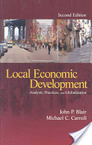
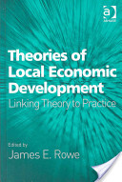
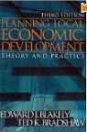
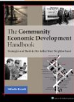

Slide 9
Two economic development models
Traditional
Recent
Attract large existing businesses and capital projects with tax credits and other subsidies
Local economic development entities compete to attract businesses
Local and state governments create direct financial incentives
Attract entrepreneurs and creative individuals by creating desirable living and connected communities
Emphasize regional economic development efforts where logical local communities build on their collaborative strengths
Local and state governments work to improve the business climate by collaborating with businesses and entrepreneurs

Slide 10
Observations and experiences
Everyone wants the next GOOGLE, sometimes at the expense of 50 small businesses.

Slide 12
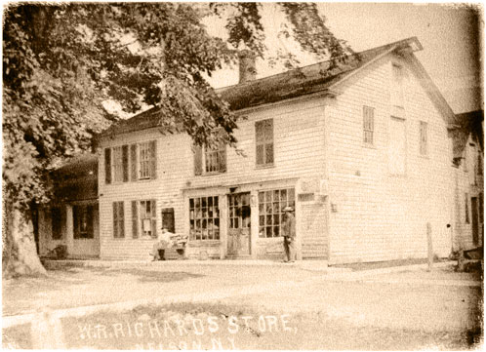

Slide 13
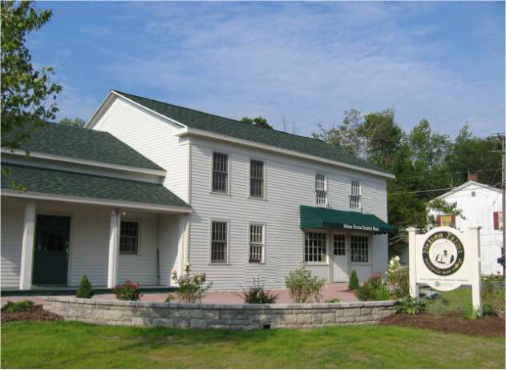

Slide 14
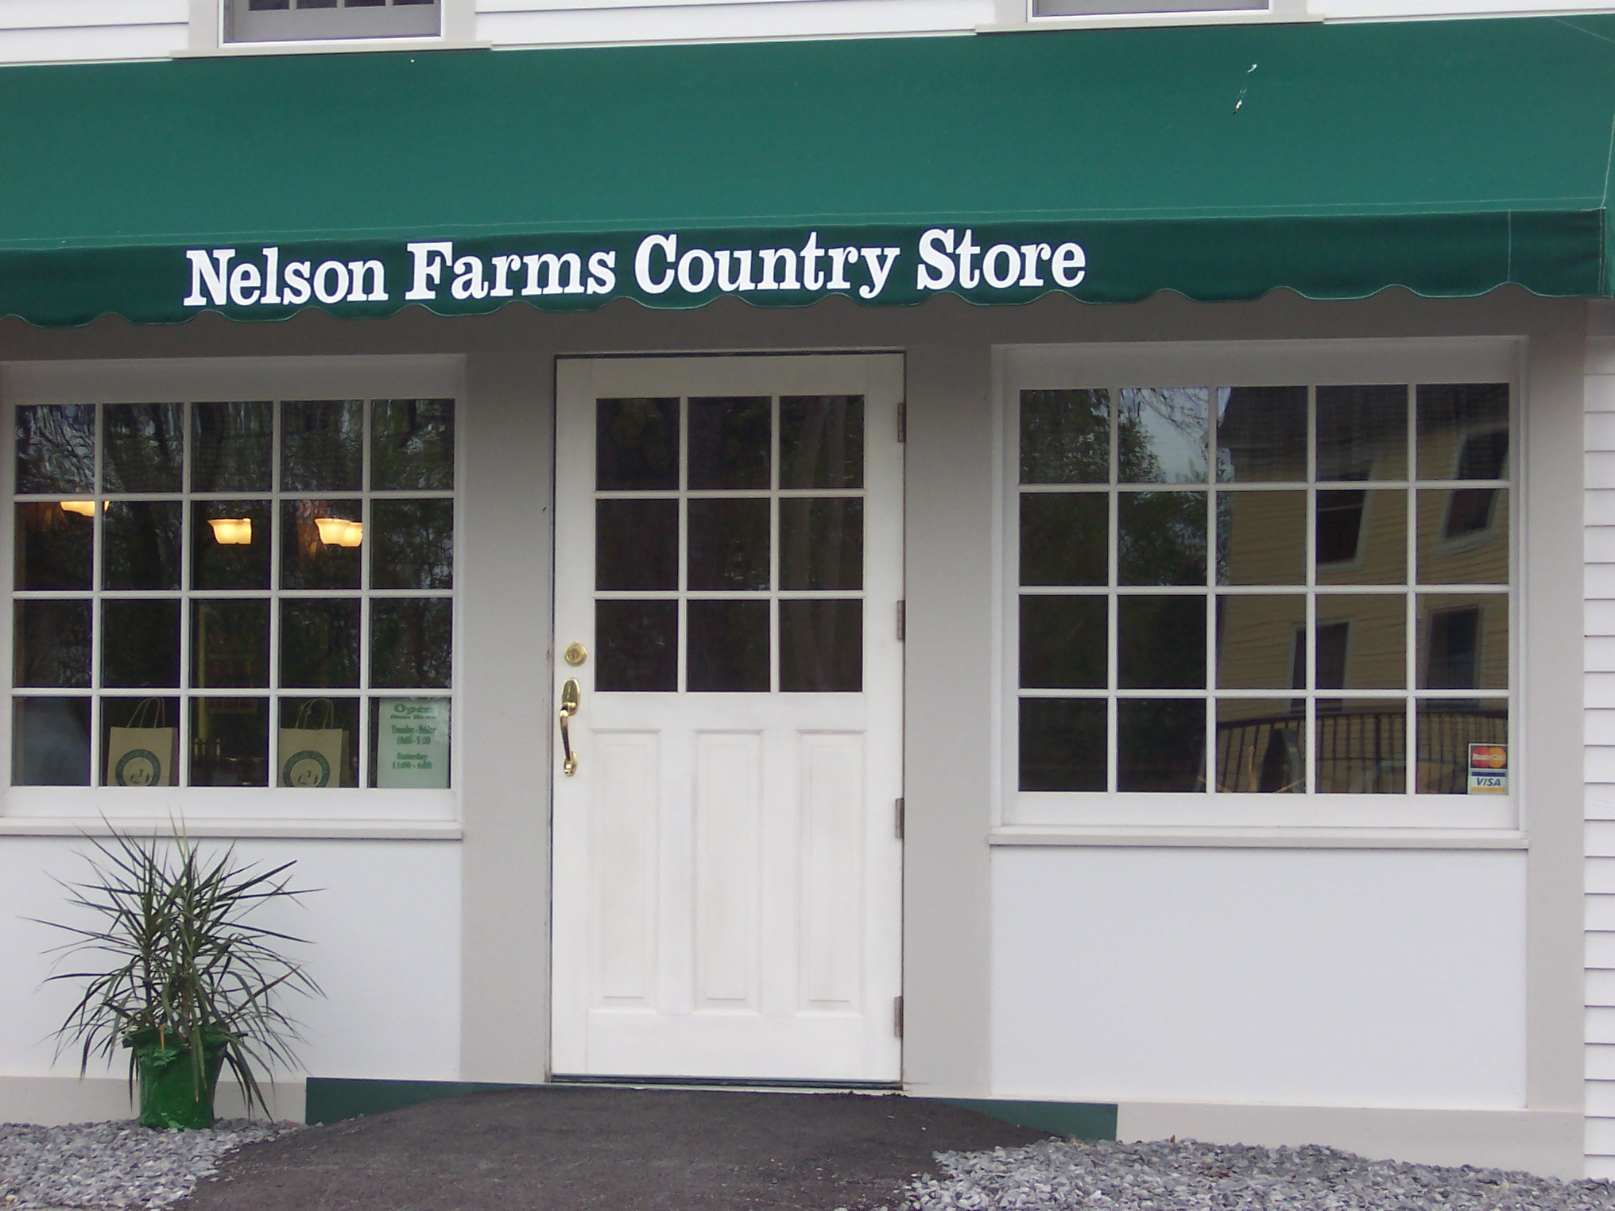

Slide 15
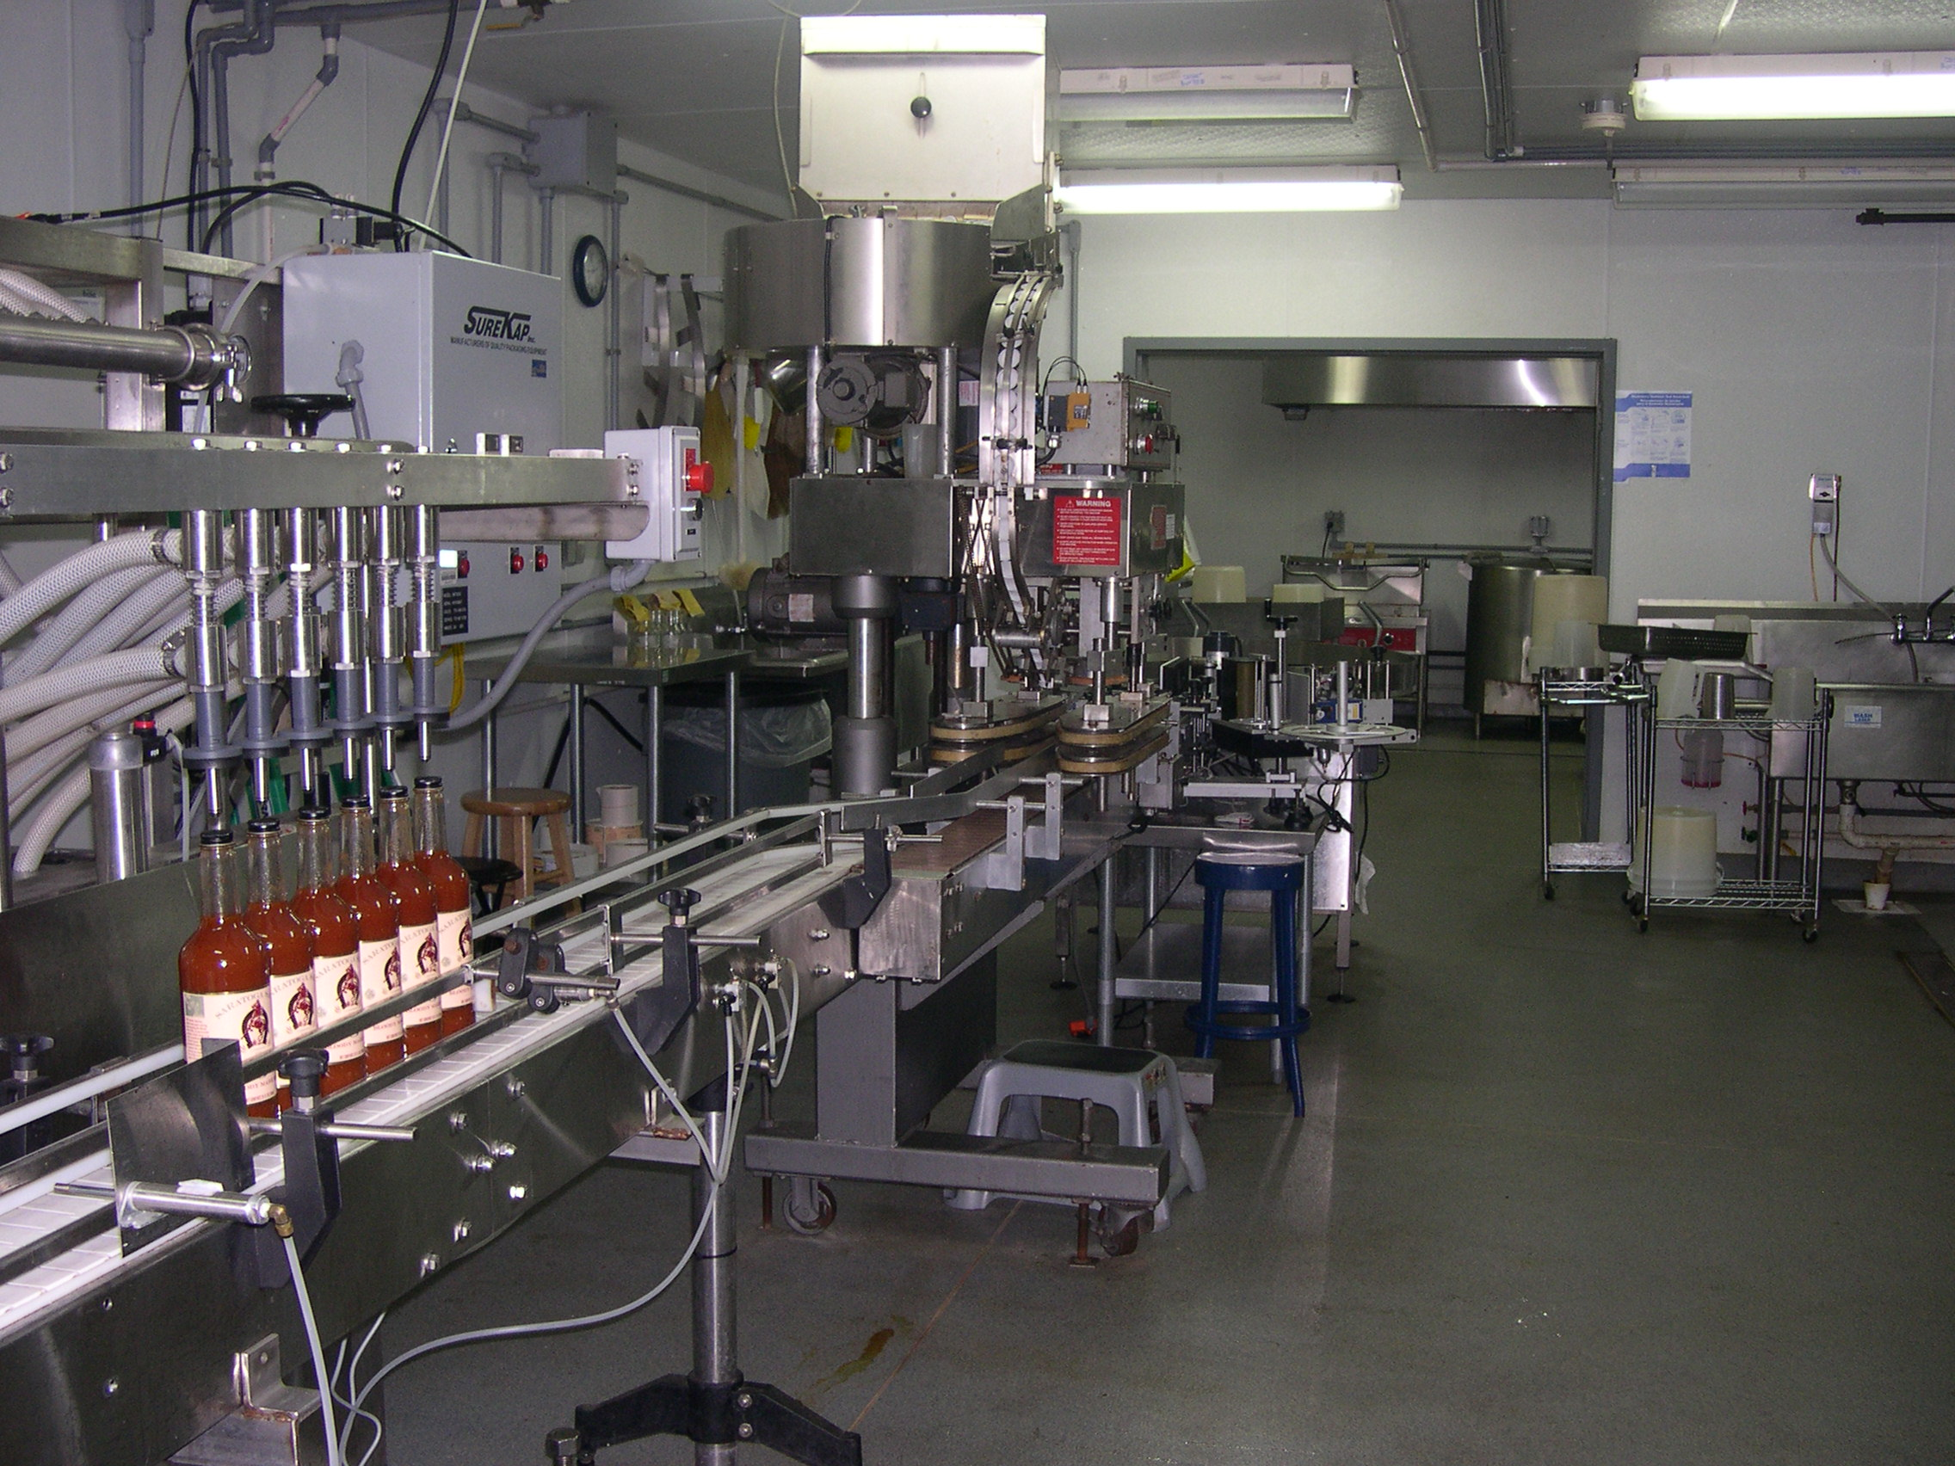
Nelson Farms Production

Slide 16
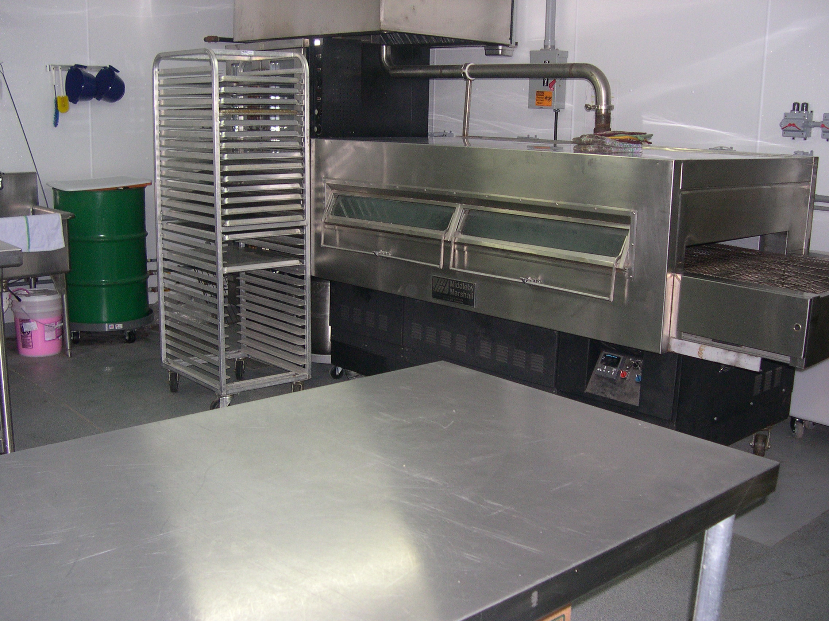
Nelson Farms Production

Slide 17
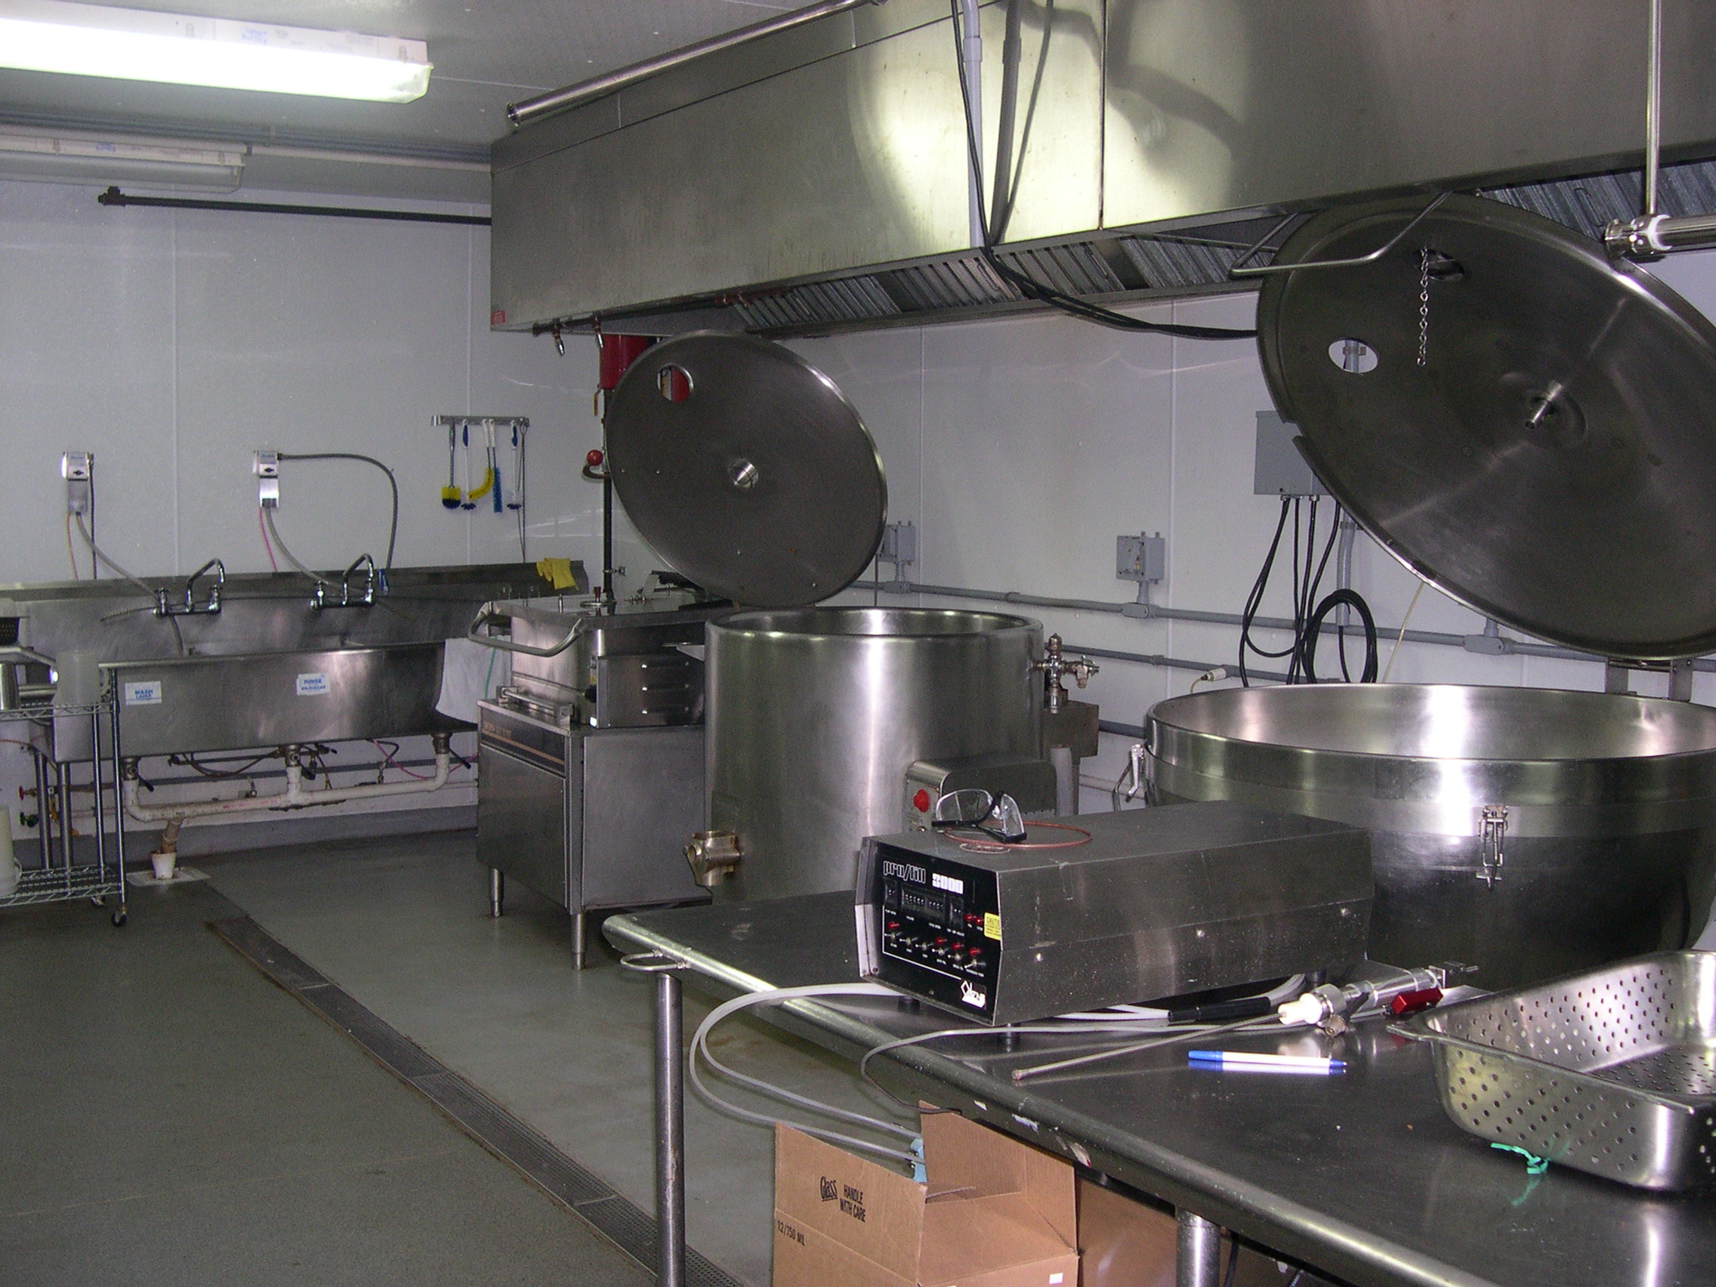
Nelson Farms Production

Slide 18
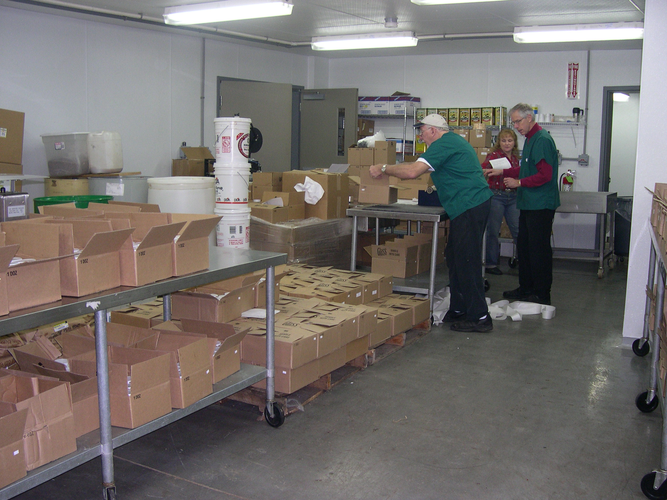
Nelson Farms Production

Slide 19
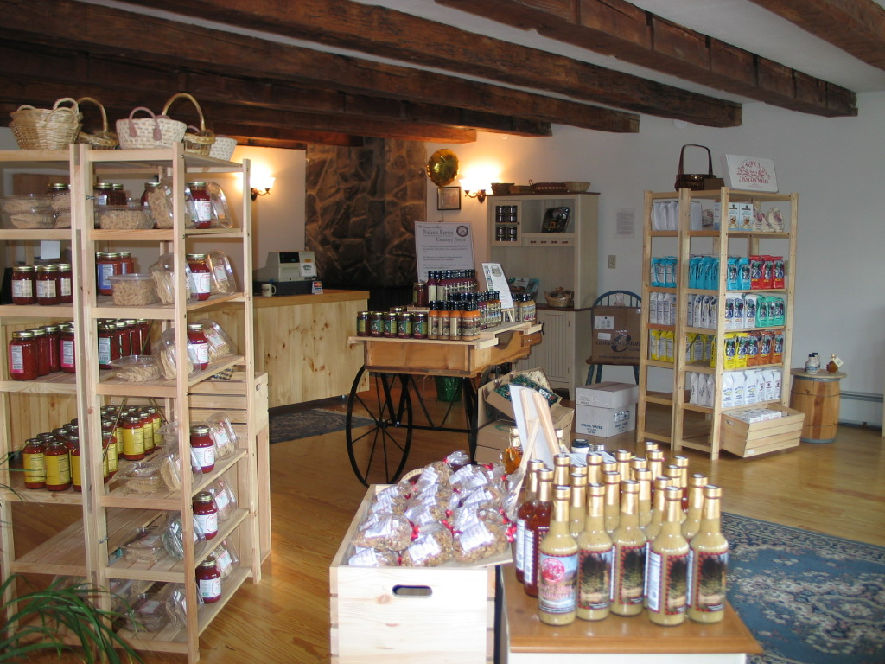
Nelson Farms Country Store

Slide 20
Nelson Farms

Slide 21
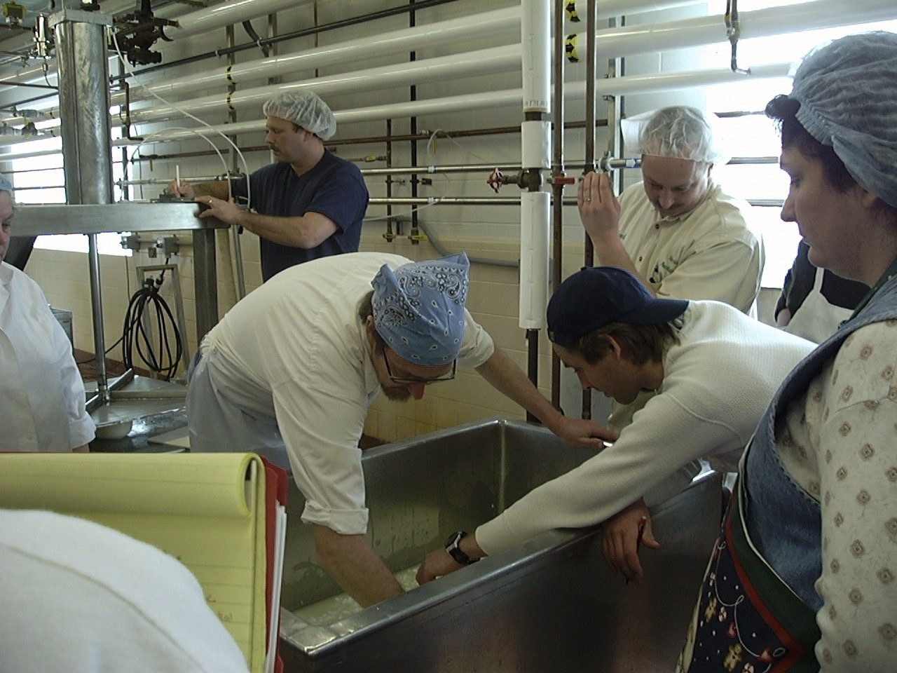
Dairy processing plant

Slide 22
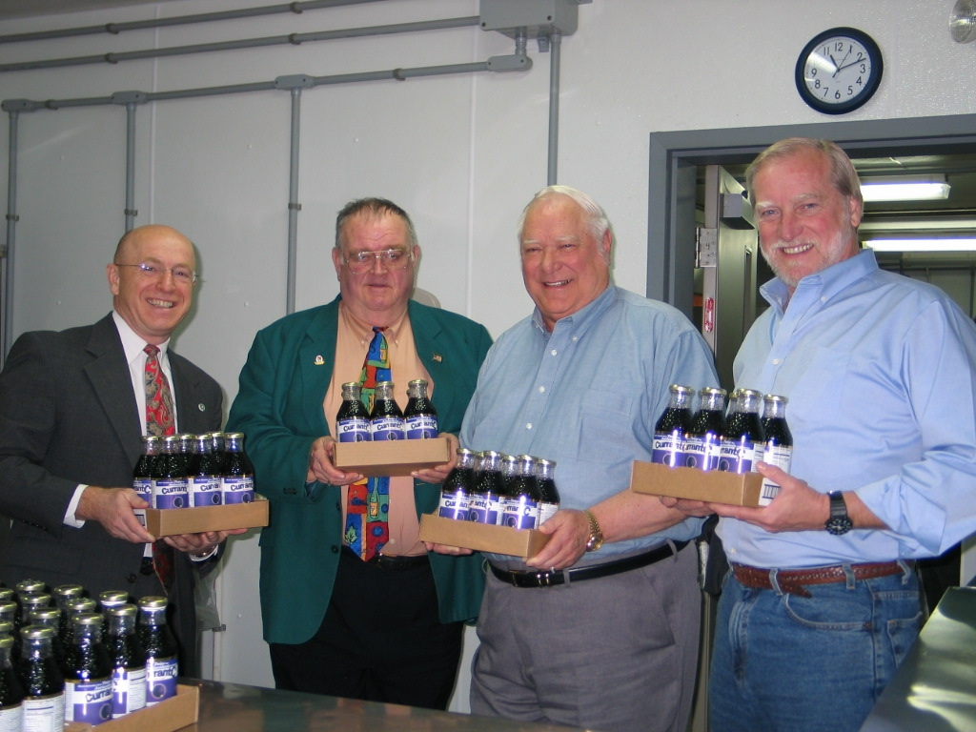
Client: AuCurrant

Slide 23
Client: Saratoga Salsa
Six products produced at Nelson Farms include salsa, cocktail sauce & Bloody Mary mix
4,500 units per month
National awards

Slide 24
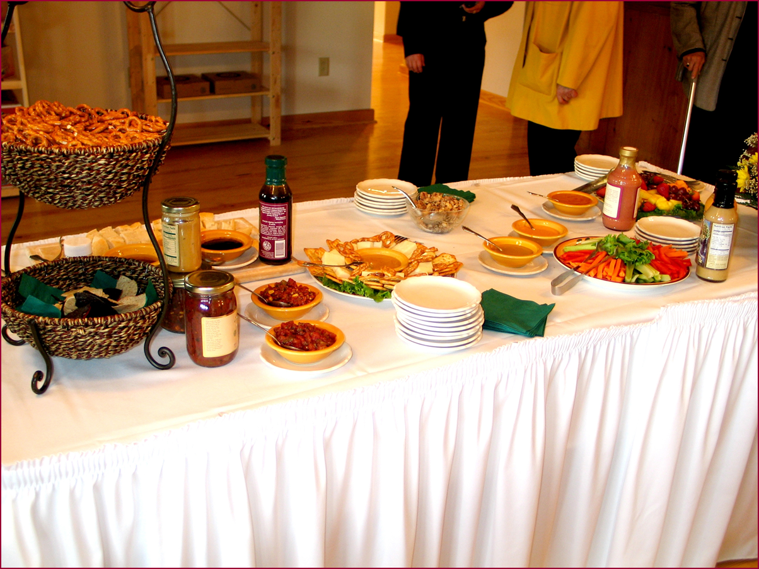
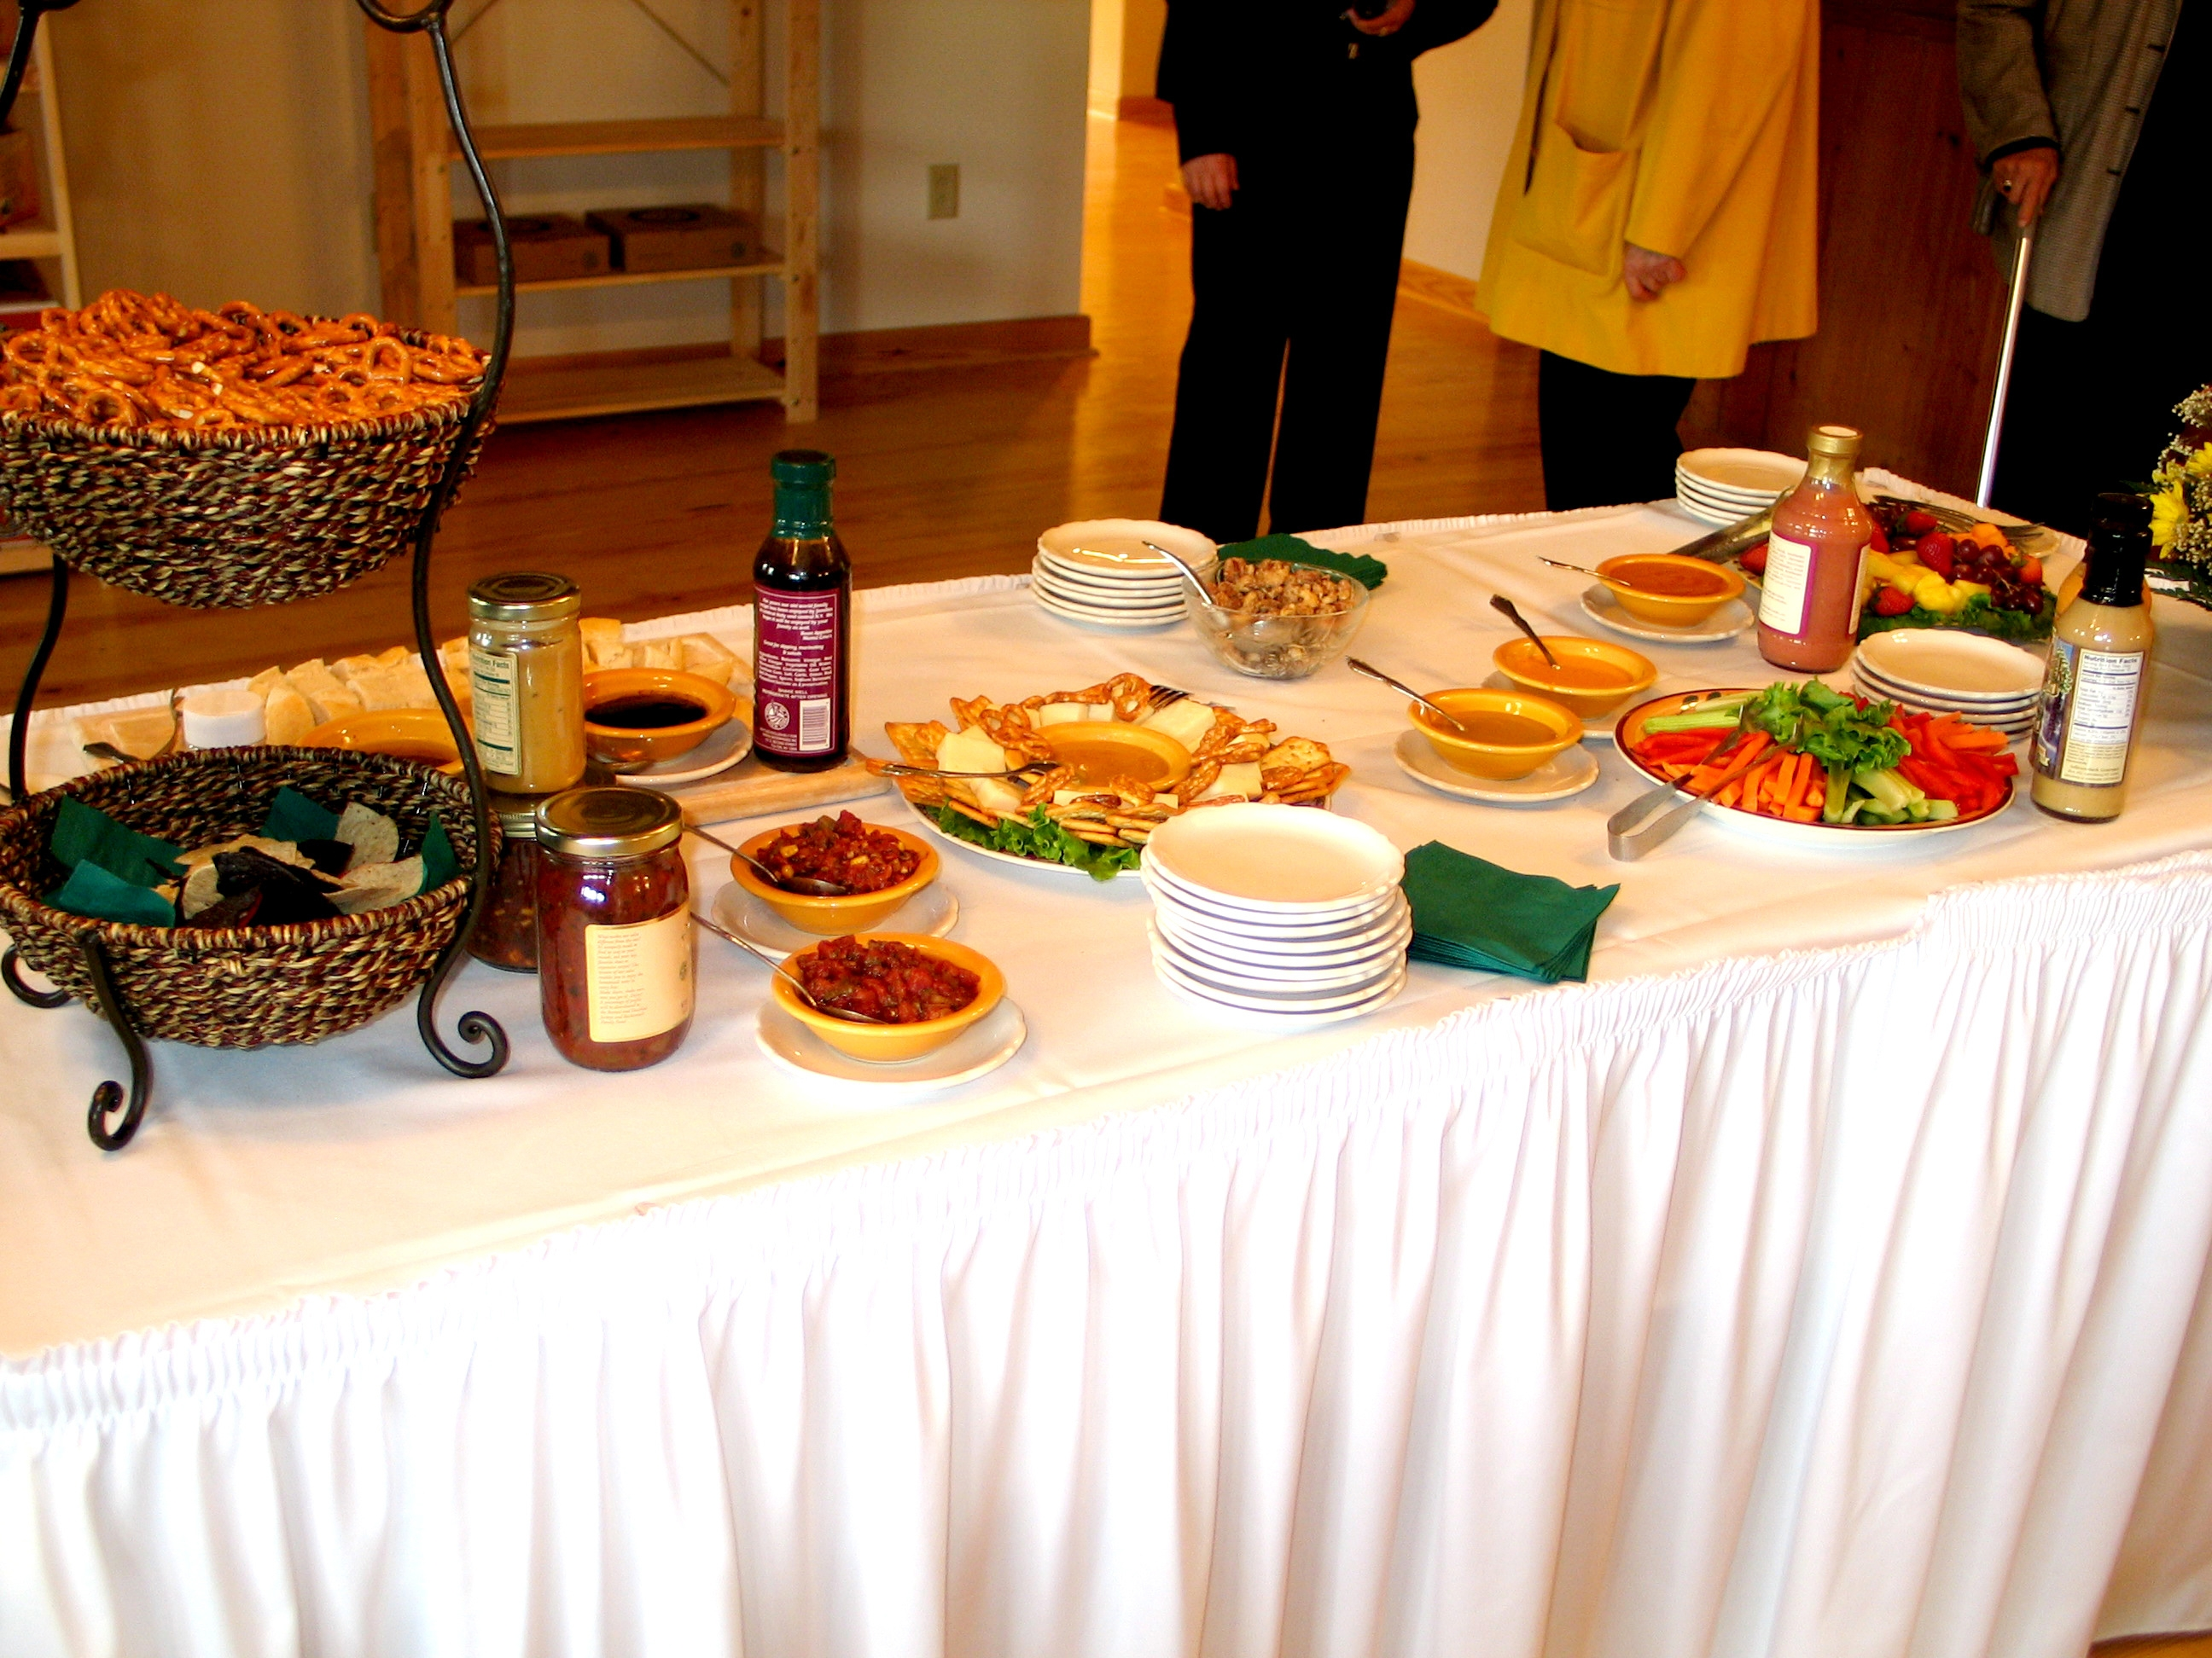
Tastings and promotions with clients

Slide 25
Successes . . .
450+ products with over 400 entrepreneurs
Nationally recognized “co-packing” expertise
Sustainable – does not require grants to operate
Noticeable growth in specialty food activity in Central New York – County Ag Dev Specialist

Slide 26
. . . and failures
Weak distribution model
Unable to entice “entrepreneurial graduates” to remain once they become successful

Slide 28
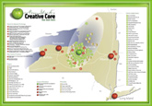
Central New York’s regional economic development entity

Slide 29
Successes . . .
Sandbox entrepreneurial project
Boot camp for entrepreneurs
e2e example
Several solid startups

Slide 30
. . . and failures
Urban model
Local disputes over regional approach
Required major marketing effort

